Slide 1

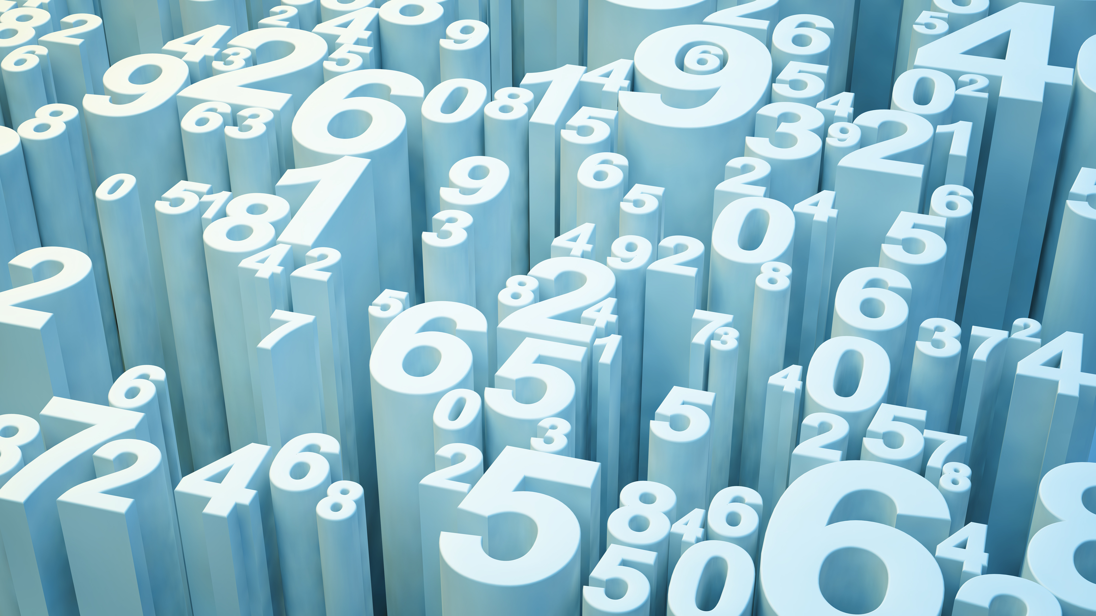
Comparison between Blockchain and Holochain

Slide 2
Presented By Group-06
Name Roll
Farin Tasnuva 1966
Keya Biswas 1971
Mst. Sumiya Siddika 1975
Abier Farzana Hoque 1980
Aysha Siddiqua Sraboni 1983
Yeasmin Akter Mitu 1992
Kamrun Nahar Allo 1994

Slide 3
Introduction
In recent years there are lot of thrills spinning around Blockchain and Holochain technology.
Every industry wants to use and explore Blockchain and Holochain technology in different application like trading, supply chain, healthcare etc.
In this slide we will discuss the comparison between Blockchain and Holochain technology.

Slide 4
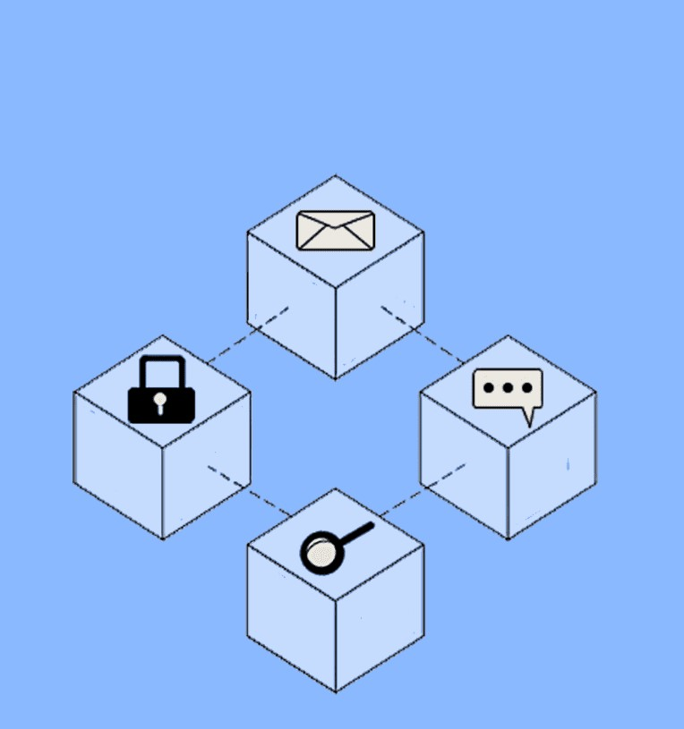
What is Blockchain?
A digital database or ledger that is distributed among the nodes of a peer to peer network.
Created by the unknown persons behind the online cash currency bitcoin, under the pseudonym of Satoshi Nakamoto.

Slide 5
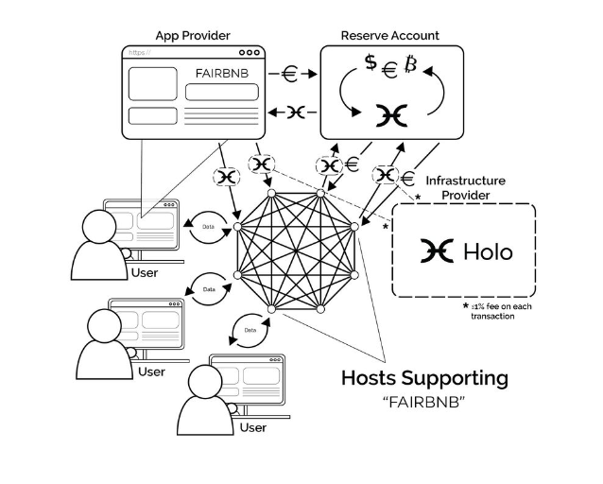
What is Holochain?
Holochain is an open source framework for building fully distributed, peer-to-peer application
Arthur Brock has 2 current jobs as Founder & CTO at Holo and Systems Architect & CoFounder at Holochain .

Slide 6
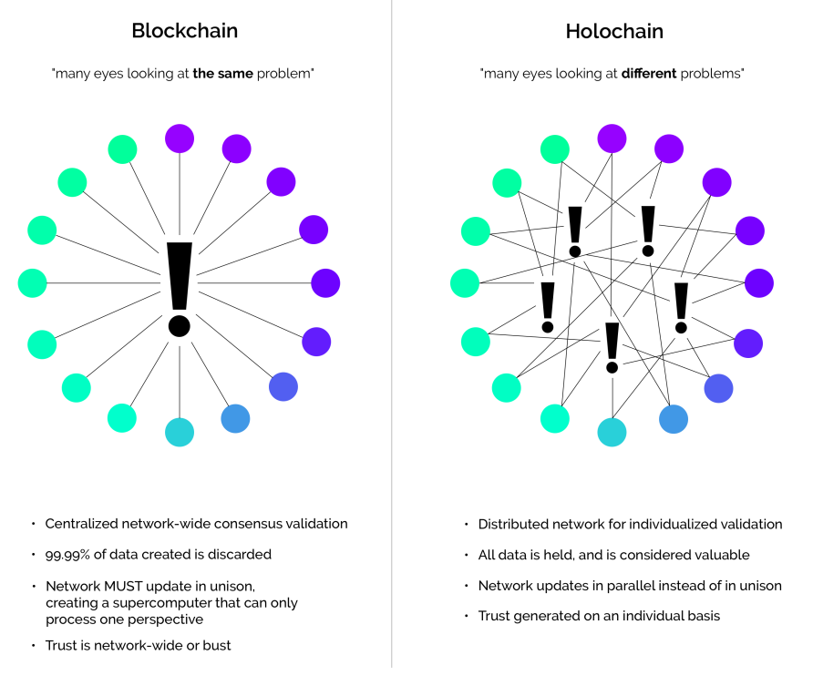
Comparison between blockchain and holochain

Slide 7
Cont.
Data Storage: Blockchain stores all data in a single chain, while Holochain stores data in individual hash chains.
Scalability: Blockchain struggles with scalability due to its consensus mechanism and data storage limitations, while Holochain is designed to be highly scalable.

Slide 8
Cont.
Consensus Mechanism: Blockchain uses a proof-of-work or proof-of-stake consensus mechanism. A consensus algorithm is a procedure through which all the peers of the Blockchain network reach a common agreement about the present state of the distributed ledger.
while Holochain uses a distributed hash table and agent-centric consensus.
Security: Blockchain is secure due to its decentralized nature and cryptographic algorithms, while Holochain provides additional security through its agent-centric architecture.

Slide 9
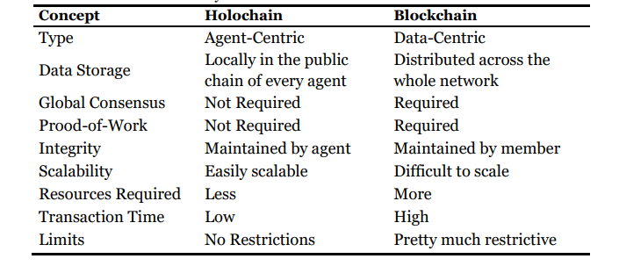
Summary of differences between Holochain and Blockchain

Slide 10
Use Case
Blockchain: Cryptocurrency, supply chain management, secure data sharing.
Holochain: Decentralized applications, social networks, sharing economy platforms.

Slide 11
Applications & Future Usage of Holochain & Blockchain Technology
Following are the applications of Holochain Technology:
• Social Media
• Identity Management
• Can be used as a currency where the complexity of the transactions is much higher.
• Holochain can also be incorporated in e-governance mechanisms.
• Can be used to implement supply chain management solutions by developing collaborative applications.
• It can also be used in various applications for economy and finance sectors.

Slide 12
Cont.
Apart from the applications given above, there are also some Holochain Hackathons organized in past where the users have developed many exciting projects listed below :
• YouTube Clone
• Reddit Clone
• Chat Apps
• Games Apps
• Social Activism Apps
• Password Management App

Slide 13
Cont.
Following are the major applications where the Blockchain technology is being used:
• Healthcare viz. Pervasive Social Network, Body Sensor Network, Biomedical Health Care, etc.
• Finance: It used in the form of various cryptocurrencies as well as for smart contracts, mining, internet banking systems, payment, etc.
• Internet of Things: It is used for security purpose in the implementation of smart city and smart home devices as well as in providing security in all the major IoT Applications.
• E-Governance and Power grid: It is already implemented by many Governments in their electronic governance systems as well as in nation-wide power grids for robust security.
• Cloud Computing: When Blockchain is implemented in a cloud application, there is an additional amount of security that is available in it.

Slide 14
Discussion
Blockchain has two core issues which have prevented its widespread adoption: scalability and environmental impact.
The architecture of blockchain means that all participating nodes must store and validate all of the data. This creates a large amount of overhead, which does not scale well. Similarly, there is growing awareness that the energy requirements of validating blockchain transactions run counter to global efforts to mitigate climate change.

Slide 15
Why Holochain is better?
Holochain's architecture is fundamentally different to blockchain, by virtue of being “agent-centric” rather than “data-centric”. That is, each piece of data does not need to be globally validated—and yet Holochain can still guarantee data validity and integrity.

Slide 16
Future Scope
The world always moves towards a technology which is easier to implement and quicker to give the solution. This makes Holochain a probable successor to Blockchain Technology. Even though, Blockchain Technology is very much in usage and has been implemented across various domains in today’s world, it is very much likely that Holochain may replace it as it seems very much advanced and quick from the perspective of working and implementation.

Slide 17
Conclusion
Both Blockchain and Holochain have their own strengths and weaknesses, and the choice between the two depends on the specific requirements of the use case.
While Blockchain is a well-established technology, Holochain offers a more efficient and scalable alternative for certain use cases

Slide 18
References
[1] Chen, G. et al. (2018). Exploring Holochain technology and its potential applications for education. Smart Learning Environments, 5(1).
[2] Nakamoto, S. (2008). Bitcoin: A peer-to-peer electronic cash system. https://bitcoin.org/bitcoin.pdf
[3] Underwood, S. (2016). Blockchain beyond Bitcoin. Communications of the ACM, 59(11): 15–17.
[4] Jaoude, J. A. and Saade, R. G. (2019). Holochain and Blockchain Applications – Usage in Different Domains. IEEE Access, 7: 45360-45381.

Slide 19
Thank You

